Slide 1
Virtualization
Lecture 1
By Corrina Alcoser

Slide 2
What is virtualization?
In computing, virtualization is when a framework divides the resource(s) into one or more execution environments.
Notes:
www.webopedia.com/TERM/V/virtualization.html
All this means is that you’re using some sort of framework, (be it vmware fusion, workstation, hyper-v, esxi,etc) to allocate resources to VM or virtual machines.

Slide 3
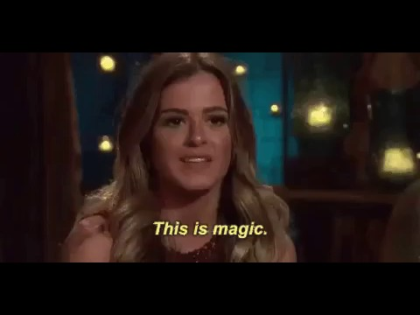
What is virtualization?
Notes:
www.webopedia.com/TERM/V/virtualization.html
All this means is that you’re using some sort of framework, (be it vmware fusion, workstation, hyper-v, esxi,etc) to allocate resources to VM or virtual machines.

Slide 4
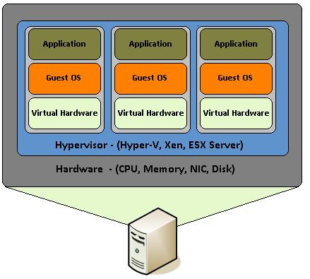
Like this!

Slide 5
What is a Virtual Machine?
Virtual machines is a software computer, typically called an “Image” or “Guest OS”, and that behaves like an actual computer.
Notes:
https://pubs.vmware.com/vsphere-51/index.jsp?topic=%2Fcom.vmware.vsphere.vm_admin.doc%2FGUID-CEFF6D89-8C19-4143-8C26-4B6D6734D2CB.html
It is made up of specification and configuration files and is backed by the physical resources of a host. The host is either the OS or kernel that everything is passing through to access the resources

Slide 6
What is a Hypervisor?
The hypervisor serves as a platform for running virtual machines and allows for the consolidation of computing resources. It is also sometimes referred to as the virtual machine manager (VMM).
Notes:
https://pubs.vmware.com/vsphere-51/index.jsp?topic=%2Fcom.vmware.vsphere.vm_admin.doc%2FGUID-CEFF6D89-8C19-4143-8C26-4B6D6734D2CB.html
It is made up of specification and configuration files and is backed by the physical resources of a host. The host is either the OS or kernel that everything is passing through to access the resources

Slide 7
Types of Hypervisors
Hypervisor types:
Type 1
Type 2

Slide 8
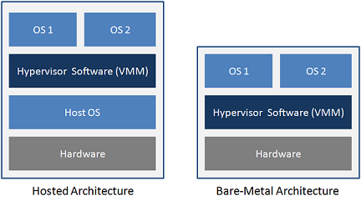

Slide 9
Type 1 Hypervisors
Directly installed on top of hardware
Is also known as:
“Bare Metal”
“Native”
“Embedded”

Slide 10
Type 2 Hypervisors
Installed on top of an OS, sometimes referred to as “Hosted” or “Application” Virtualization
Examples:
Hyper-V
VMware Workstation
VMware Fusion

Slide 11
Reasons for using VM’s
Cheaper
More efficient
Management

Slide 13
Virtual Machine States
Suspended
Powered On
Powered Off

Slide 14
Suspended
During this state:
A (.vmss) file is created in the working directory and volatile memory is copied to it
Lastly the Guest system’s clock time is noted and stored in that file too then saved to disk
When the guest system(VM) is powered on again it copies the stuff save in the .vmss file back into the RAM allocated to the VM
Notes:
https://pubs.vmware.com/workstation-9/index.jsp?topic=%2Fcom.vmware.ws.get_started.doc%2FGUID-A4536112-10A6-4574-ADE5-60D9BBAE1F02.html
https://stuff.mit.edu/afs/sipb/project/vmdialup/lib/vmware-console/help-manual/preserve_suspend_gsx

Slide 15
Suspended
Some VMware tools have hard and soft suspensions as well as resumes
Ex:
Worksation
Notes:
https://pubs.vmware.com/workstation-9/index.jsp?topic=%2Fcom.vmware.ws.get_started.doc%2FGUID-A4536112-10A6-4574-ADE5-60D9BBAE1F02.html
https://stuff.mit.edu/afs/sipb/project/vmdialup/lib/vmware-console/help-manual/preserve_suspend_gsx

Slide 16
Powered On
Turns on guest OS
During this time system resources are allocated to the current running VM’s
This is when CPU scheduling starts
5 milliseconds is longest a VM can hold a resource. (will only use full time in high volume environments)
Notes:
https://pubs.vmware.com/workstation-9/index.jsp?topic=%2Fcom.vmware.ws.get_started.doc%2FGUID-A4536112-10A6-4574-ADE5-60D9BBAE1F02.html
https://stuff.mit.edu/afs/sipb/project/vmdialup/lib/vmware-console/help-manual/preserve_suspend_gsx

Slide 17
Powered Off
Guest OS is powered off and all resources are released
Notes:
https://pubs.vmware.com/workstation-9/index.jsp?topic=%2Fcom.vmware.ws.get_started.doc%2FGUID-A4536112-10A6-4574-ADE5-60D9BBAE1F02.html
https://stuff.mit.edu/afs/sipb/project/vmdialup/lib/vmware-console/help-manual/preserve_suspend_gsx

Slide 18
Orphaned VM’s
Not a true state
All this means that the hypervisor cannot access the:
* .vmdk file
* .vmx file
* .vmxf

Slide 19
What causes Orphaned VM’s?
The hypervisor is not up to date with the datastore
File is no longer there
The image is corrupted

Slide 20
Critical Files For VM’s
* .vmdk file
* .vmx file
* .vmxf file
Notes:
https://pubs.vmware.com/vsphere-4-esx-vcenter/index.jsp#com.vmware.vsphere.vmadmin.doc_41/vsp_vm_guide/about_vms_in_vsp_datacenter/c_what_is_a_virtual_machine.html?resultof=%2522%252e%2576%256d%2573%2573%2522%2520%2522%2576%256d%2573%2573%2522%2520

Slide 21
Virtual Disk Files
A virtual disk: hides a physical storage layer from the virtual machine’s operating system. It also acts as a medium for getting the hypervisor to allocate disk resources to meet the specifications it has
This allows you to run VM’s with operating systems that are not certified for specific storage equipment.
Notes:
https://pubs.vmware.com/vsphere-4-esx-vcenter/index.jsp#com.vmware.vsphere.vmadmin.doc_41/vsp_vm_guide/about_vms_in_vsp_datacenter/c_what_is_a_virtual_machine.html?resultof=%2522%252e%2576%256d%2573%2573%2522%2520%2522%2576%256d%2573%2573%2522%2520

Slide 22
Virtual Disk Files
These have the * .vmdk and *-flat.vmdk file extension
* .vmdk:
Updates as disk is utilized
*-flat.vmdk:
Are preallocated virtual disk
Made upon creation of VM
Notes:
https://pubs.vmware.com/vsphere-4-esx-vcenter/index.jsp#com.vmware.vsphere.vmadmin.doc_41/vsp_vm_guide/about_vms_in_vsp_datacenter/c_what_is_a_virtual_machine.html?resultof=%2522%252e%2576%256d%2573%2573%2522%2520%2522%2576%256d%2573%2573%2522%2520

Slide 23
Virtual Machine Maximums
Compute:
Virtual CPUs per virtual machine (Virtual SMP) 128
Memory:
RAM per virtual machine 6128 GB
Virtual machine swap file size 6128 GB
VMFS3 with 1 MB block maximum swap size is 255 GB.
Recommended solution is VMFS5, not VMFS3 with bigger block size.
Notes:
https://pubs.vmware.com/

Slide 25
Virtual SMP (VSMP)
Virtual SMP or VSMP refers to a method of SMP (Symmetric Multi-Processing) in which two or more virtual processors are mapped inside a single virtual machine or partition.
Notes:
https://pubs.vmware.com/vsphere-4-esx-vcenter/index.jsp#com.vmware.vsphere.vmadmin.doc_41/vsp_vm_guide/about_vms_in_vsp_datacenter/c_what_is_a_virtual_machine.html?resultof=%2522%252e%2576%256d%2573%2573%2522%2520%2522%2576%256d%2573%2573%2522%2520

Slide 26
ESXI Maximus
Host CPU maximums:
Logical CPUs per host 576
Virtual machine maximums:
1024 VM’s per ESXI host
Virtual CPUs per host - 4096 vCPU
Virtual CPUs per core - 32
Notes:
The achievable number of vCPUs per core depends on the workload and specifics of the hardware. For more information, see the latest version of Performance Best Practices for VMware vSphere.

Slide 28
What’s a SAN?
What is a SAN?
A storage area network (SAN) is a network which provides access to consolidated, block level data storage.
NAS vs. SAN
SAN is multiple device/server/computing appliance,sharing its own storage over the network.
NAS is a single device/server/computing appliance,sharing its own storage over the network.
Notes:
The achievable number of vCPUs per core depends on the workload and specifics of the hardware. For more information, see the latest version of Performance Best Practices for VMware vSphere.

Slide 29
Virtual SAN
What is a virtual SAN?
Virtual SAN is a software-defined storage offering from VMware that enables enterprises to pool their storage capabilities and to instantly and automatically provision virtual machine storage via simple policies that are driven by the virtual machine.
Notes:
The achievable number of vCPUs per core depends on the workload and specifics of the hardware. For more information, see the latest version of Performance Best Practices for VMware vSphere.

Slide 30
Virtual Volumes
Sometimes referred to Virtual Volumes (VVOLs)
It is:
integration and management framework for external storage that provides finer control at the VM-level, streamlines storage operation and offers flexibility of choice.
Notes:
The achievable number of vCPUs per core depends on the workload and specifics of the hardware. For more information, see the latest version of Performance Best Practices for VMware vSphere.

Slide 31
Snapshots
A VMware snapshot is a copy of the virtual machine's disk file (VMDK) at a given point in time.
Snapshots provide a change log for the virtual disk and are used to restore a VM to a particular point in time
A Take Snapshot operation creates .vmdk, -delta.vmdk, vmsd, and vmsn files.
Notes:
The achievable number of vCPUs per core depends on the workload and specifics of the hardware. For more information, see the latest version of Performance Best Practices for VMware vSphere.

Slide 32
A SNAPSHOT IS NOT THE SAME AS A BACKUP!!!!

Slide 33


Slide 34
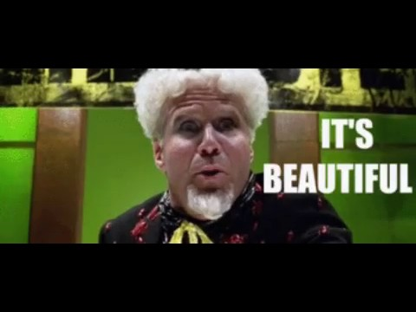
Networking??
Yes!!!!
Hypervisors have their own internal networking!!
Notes:
The achievable number of vCPUs per core depends on the workload and specifics of the hardware. For more information, see the latest version of Performance Best Practices for VMware vSphere.

Slide 35
Networking for VMs
Components:
vNICs
pNICs
vSwitches
Dynamic
Standard
NFS
iSCSI
Notes:
The achievable number of vCPUs per core depends on the workload and specifics of the hardware. For more information, see the latest version of Performance Best Practices for VMware vSphere.

Slide 36
Until Next Time ...
Notes:
The achievable number of vCPUs per core depends on the workload and specifics of the hardware. For more information, see the latest version of Performance Best Practices for VMware vSphere.

